Slide 1

Lesson 4- Page Sections and the CSS Box Model

Slide 2
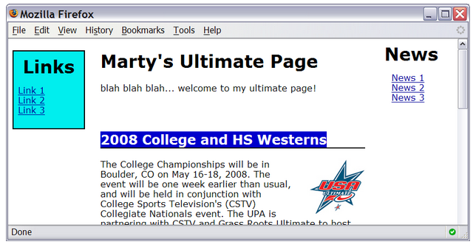
Motivation for page sections
want to be able to style individual elements, groups of elements, sections of text or of the page
(later) want to create complex page layouts

Slide 3
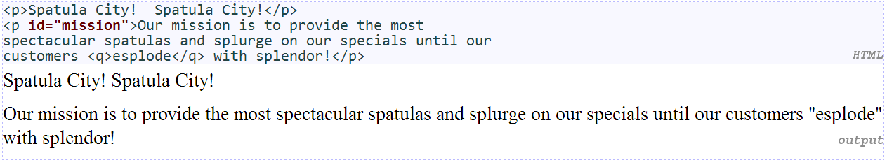
The HTML id attribute
allows you to give a unique ID to any element on a page
each ID must be unique; can only be used once in the page

Slide 4
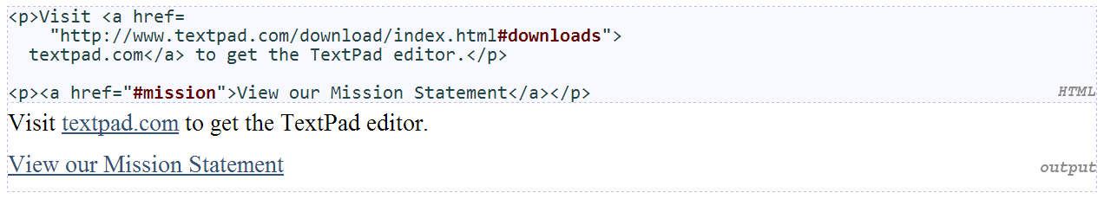
Linking to sections of a web page
a link target can include an ID at the end, preceded by a #
browser will load that page and scroll to element with given ID

Slide 5
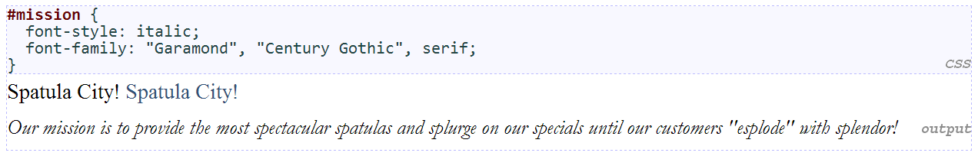
CSS ID selectors
applies style only to the paragraph that has the ID of mission
element can be specified explicitly: p#mission {

Slide 6
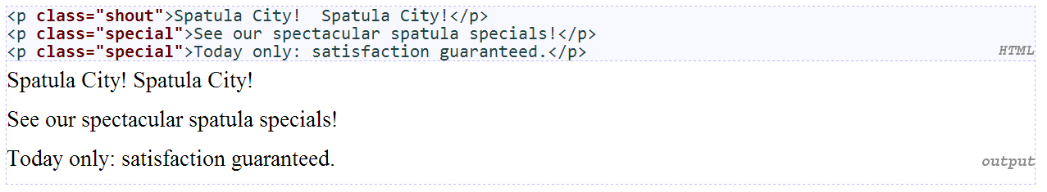
The HTML class attribute
classes are a way to group some elements and give a style to only that group (“I don't want ALL paragraphs to be yellow, just these three...”)
unlike an id, a class can be reused as much as you like on the page

Slide 7
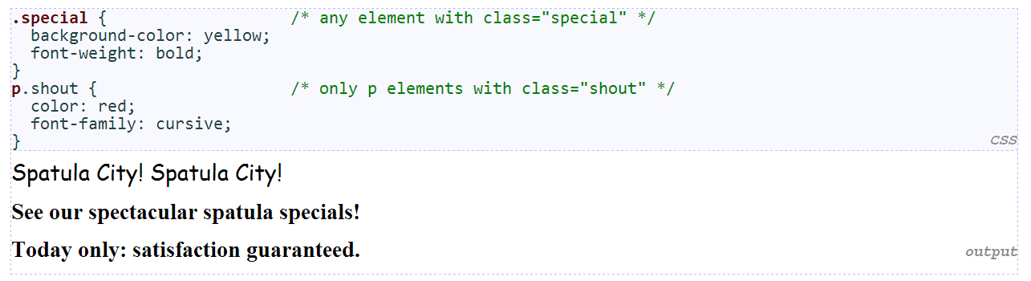
CSS class selectors
applies rule to any element with class special, or a p with class shout

Slide 8
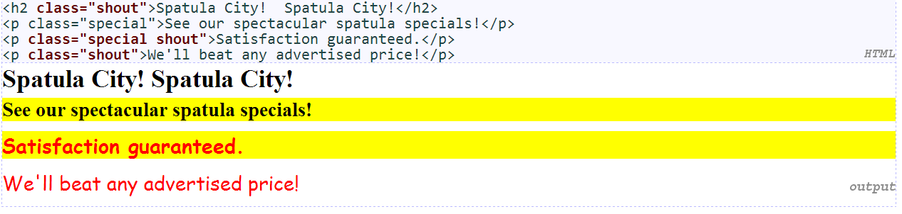
Multiple classes
an element can be a member of multiple classes (separated by spaces)

Slide 9
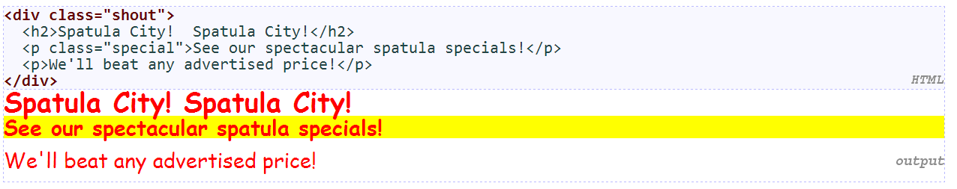
Sections of a page: <div>
a section or division of your HTML page (block)
a tag used to indicate a logical section or area of a page
has no appearance by default, but you can apply styles to it

Slide 10
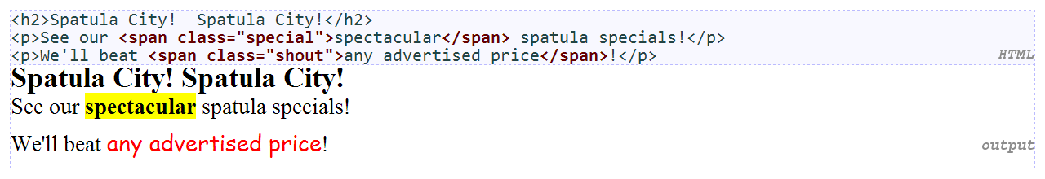
Inline sections: <span>
an inline element used purely as a range for applying styles
has no onscreen appearance, but you can apply a style or ID to it, which will be applied to the text inside the span

Slide 11
CSS context selectors
applies the given properties to selector2 only if it is inside a selector1 on the page
applies the given properties to selector2 only if it is directly inside a selector1 on the page (selector2 tag is immediately inside selector1 with no tags in between)

Slide 12
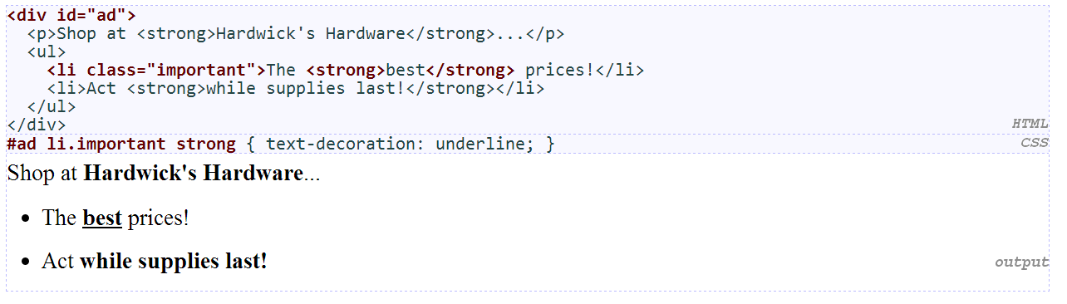
More complex example

Slide 13
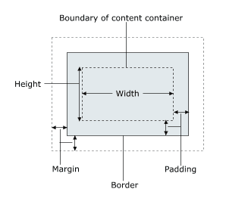
The CSS Box Model
for layout purposes, every element is composed of:
the actual element's content
a border around the element
padding between the content and the border (inside)
a margin between the border and other content (outside)
width = content width + L/R padding + L/R border + L/R margin height = content height + T/B padding + T/B border + T/B margin

Slide 14
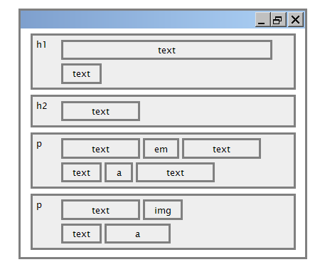
Document flow - block and inline elements

Slide 15
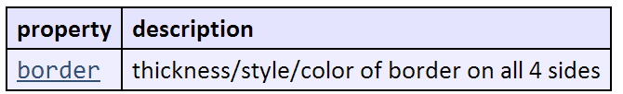
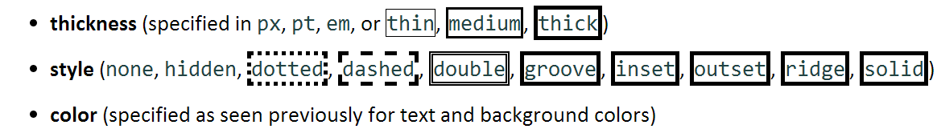
CSS properties for borders

Slide 16
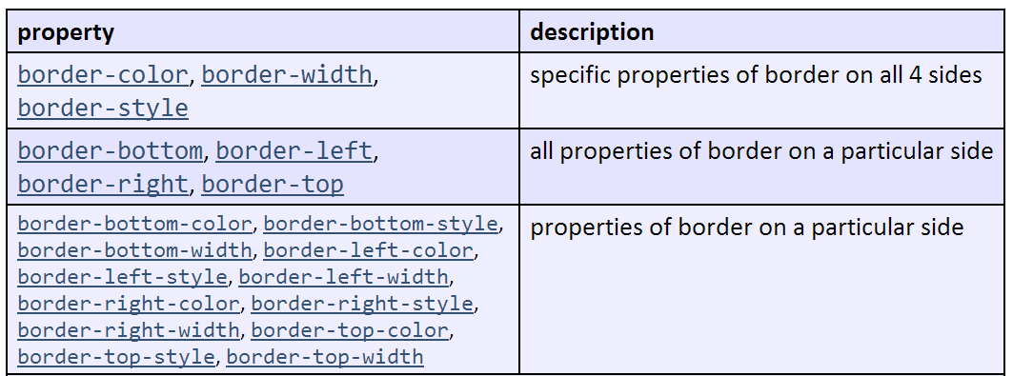
More border properties

Slide 17
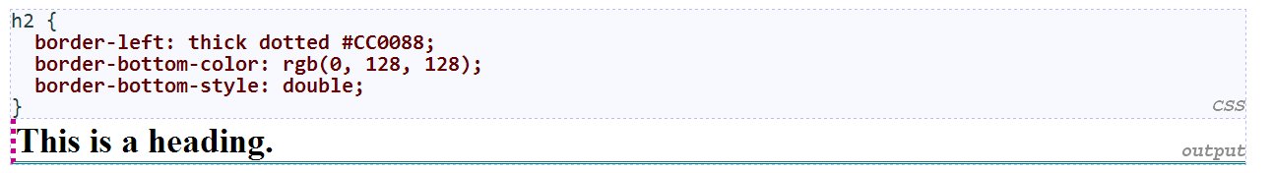
Border example 2
each side's border properties can be set individually
if you omit some properties, they receive default values (e.g. border-bottom-width above)

Slide 18
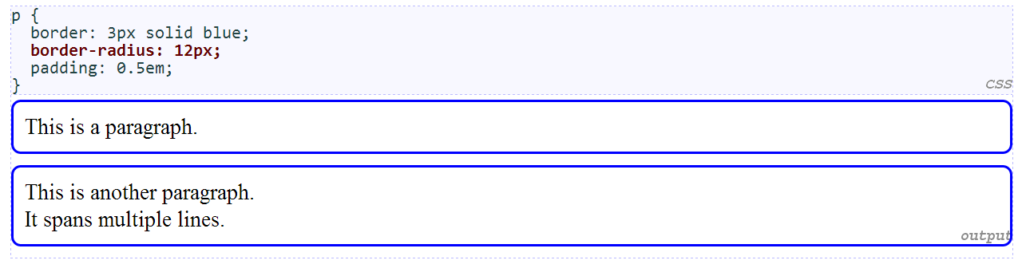
Rounded corners with border-radius
each side's border radius can be set individually, separated by spaces

Slide 19
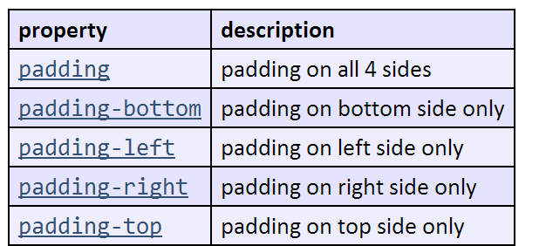
CSS properties for padding

Slide 20
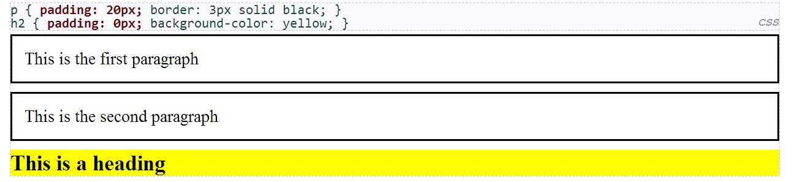
Padding example 1

Slide 21
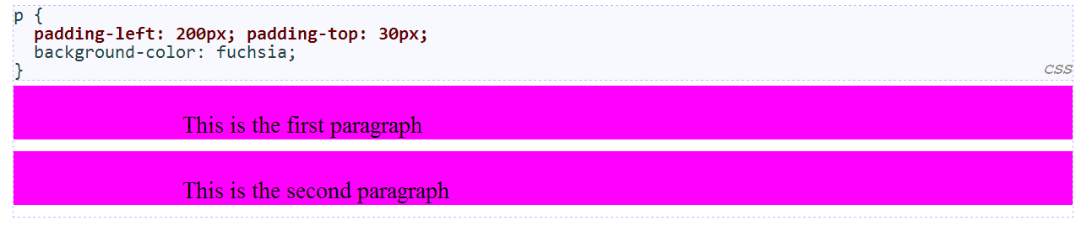
Padding example 2
each side's padding can be set individually
notice that padding shares the background color of the element

Slide 22
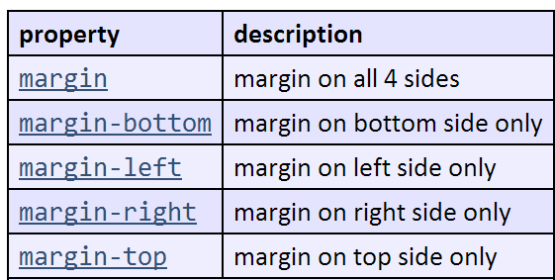
CSS properties for margins

Slide 23
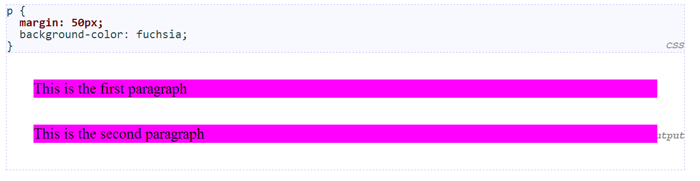
Margin example 1
notice that margins are always transparent (they don't contain the element's background color, etc.)

Slide 24
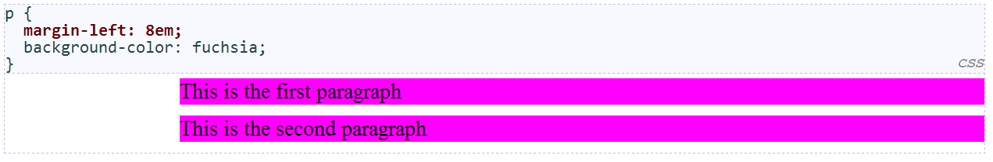
Margin example 2
each side's margin can be set individually

Slide 25
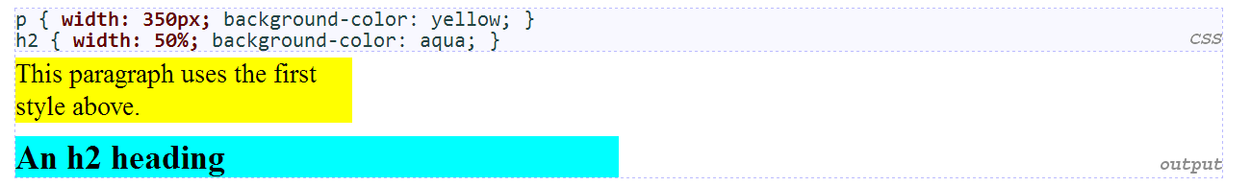
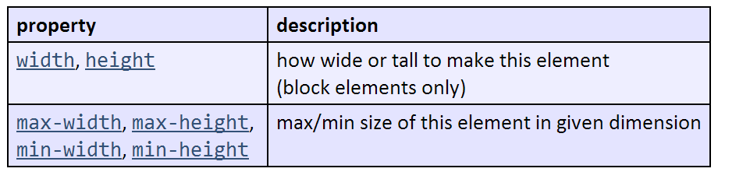
CSS properties for dimensions

Slide 26
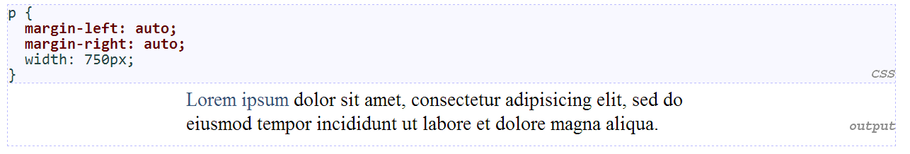
Centering a block element: auto margins
works best if width is set (otherwise, may occupy entire width of page)
to center inline elements within a block element, use text-align: center;

Slide 27
Q & A

